Slide 1
Using COMSOL On Kestrel, Part II: Advanced Tutorial
Xin He, Xin.He@NREL.gov
Complex Systems Simulation and Optimization Group
2.28, 2024
Notes:
Good morning, everyone. Welcome to this training. I am xin he from the complex systems simulation and optimization group. Today I am going to give the second part of the tutorial about using comsol on Kestrel.

Slide 2
Tutorial about COMSOL On Kestrel
I). Introductory tutorial
Introduction of COMSOL on Kestrel
Using COMSOL graphic user interface (GUI) on Kestrel
Running COMSOL in batch mode on Kestrel
Scaling performance
https://nrel.sharepoint.com/sites/ComputationalSciencesTutorials/Lists/Computational%20Sciences%20Tutorial%20Recordings/AllItems.aspx?viewid=7b97e3fa%2Dedf6%2D48cd%2D91d6%2Df69848525ba4&playlistLayout=playback&itemId=73
II). Advanced tutorial
Fuel cell model based
Parametric study
Equation-based simulation in COMSOL
Estimation of parameter based on experiments results
Notes:
This training is the second part of our planned training series which consists of an introductory tutorial and an advanced tutorial. In the introductory tutorial, we talked about license of COMSOL on kestrel, using comsol graphic user interface and running comsol in batch mode on kestrel and the scaling performance of comsol on kestrel. If you are interested in this introductory training bu was not able to attend, you can fid the recording at this link.
For today’s advanced tutorial, we will cover several advanced operations including parametric study, equation-based simulation, and parameter estimation based on a fuel cell model.

Slide 3
Outline
1
Hydrogen Fuel Cell Module
2
Parametric Study
3
Equation-based Simulations
4
Estimation of Parameters Based on Experimental Results
5
Demo (https://github.nrel.gov/hpc-apps/COMSOL-Training/tree/main/Advanced-Training)
Notes:
Here is a more detailed outline of today’s tutorial, we will talk about the hydrogen fuel cell module, parametric study based on parametric sweep, auxiliary sweep, batch sweep, or cluster sweep, equation-based simulation using general pde node in mathematics module, parameter estimation based on experimental results using parameter estimation node or optimization module, At the end, I will give a demo which would cover most stuff in first four sections. The slides and models used in demo section are available on Github and you can access through this link.

Slide 4
1
Hydrogen Fuel Cell Module
Notes:
All right, let’s get started with the fuel cell module.

Slide 5
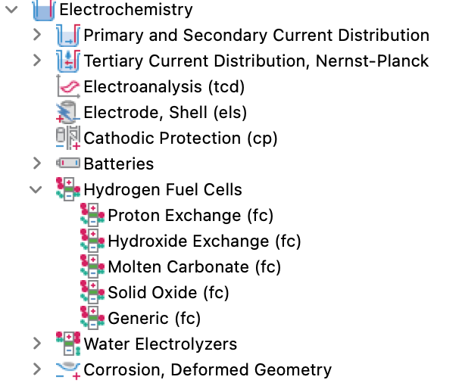
Fuel Cell Module
Notes:
Since comsol 5.6, there is a specific module called hydrogen fuel cell module under electrochemistry module. The hydrogen fuel cell module integrates electrochemistry; thermal dynamics; mass transfer, multiphase flow; and heat transfer. In this module, several types of fuel cell are included such as proton exchange fuel cell, hydroxide exchange fuel cell, molten carnonate fuel cell, solid oxide fuel cell, and generic fuel cell. Let’s look into the proton exchange module.

Slide 6
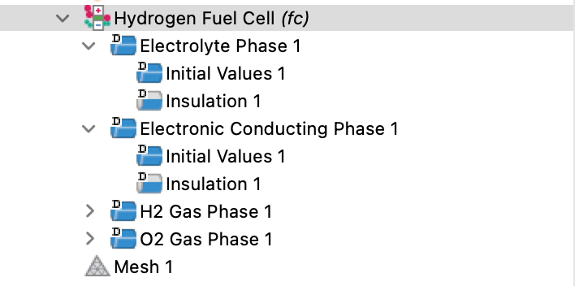
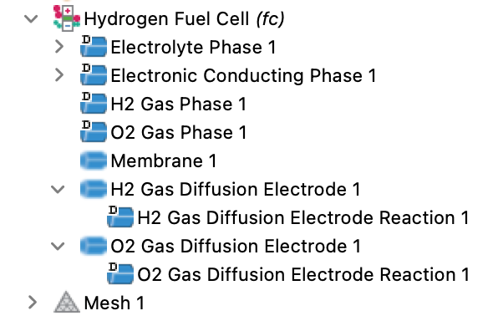
Fuel Cell Module
Notes:
Once the proton exchange fuel cell module is added, some nodes are included by default. Including electrolyte ohase, electronic conducting phase, Hydrogen and oxygen phase. Then you need to add the membrane node, anode, and cathode to the model and define the material properties and other parameters in each nodes. For more complex modeling, you can combine it with fluid simulation, and heat transfer. We will show how to build a simple fuel cell model in the demo section.

Slide 7
2
Parametric Study
Notes:
Then let’s move to the parametric study.

Slide 8
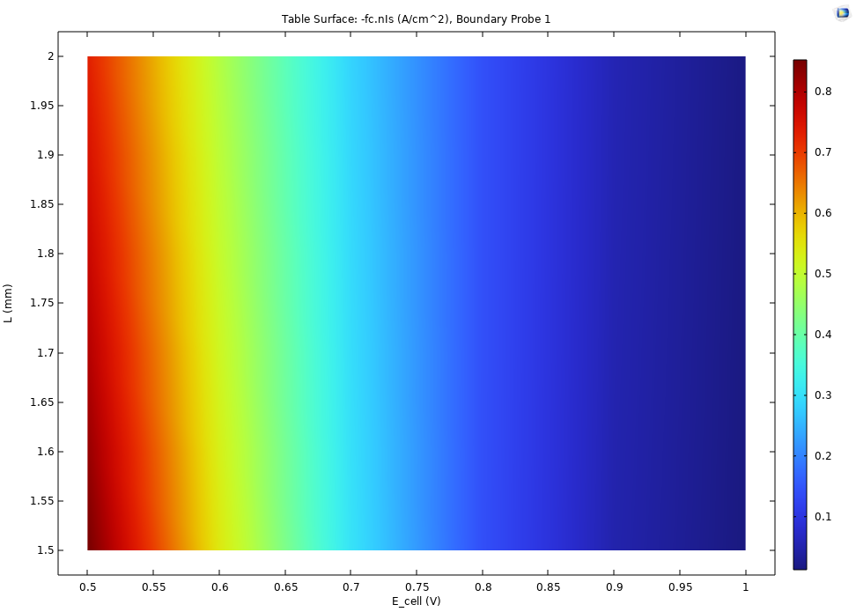
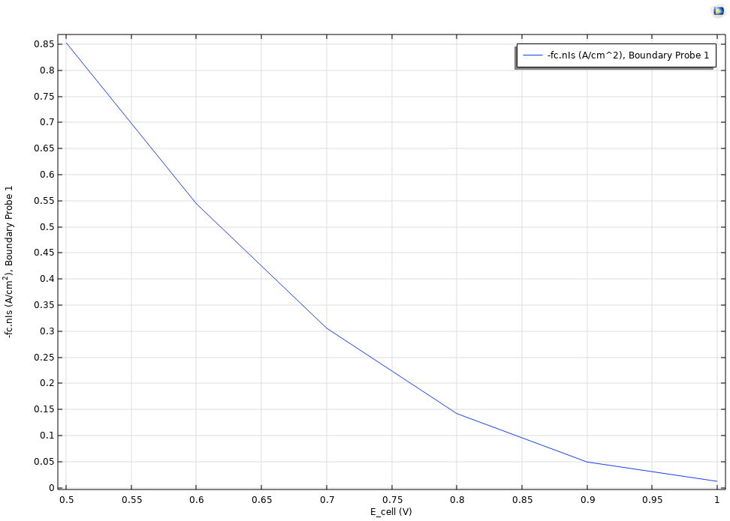
Parametric Study
Parametric study is important for fuel cell design
Ways to do parametric in COMSOL
- parametric sweep
- auxiliary sweep
- batch sweep
- cluster sweep
Notes:
Parametric study is important for fuel cell design. Typically, we want the fuel cell works with maximum output power, to do that, we need know how different parameters impact the i-v curve. The left figure show how the size of the fuel cell and the potential affect the current density. Basically, the generation of each i-v curve as shown in the right figure requires parametric study in which we sweep different output voltage or current density.
In comsol, we can conduct this parametric study in four ways: parametric sweep, auxiliary sweep, batch sweep, and cluster sweep.

Slide 9
Parametric Study
Parametric sweep:
- can sweep any parameter: material properties; boundary
conditions; geometry; mesh.
- run parallelly when distribute parametric sweep is enabled.
- results are saved in a single .mph file.
- Each MPI handle one parameter value.
Auxiliary sweep:
- cannot sweep parameters used for defining geometry and mesh.
- Run parallelly as same as parameter sweep when “distributed
parametric solver is activated”
- run faster as it use results from last parameter value.
Notes:
Here is a summary about the difference of different parametric study methods. For the parametric sweep, it can sweep any parameters including material properties, boundary conditions, and parameter used to define geometry and mesh. When the distributed parameter sweep option is enabled, it can run parallelly where each mpi works on one parameter value.
For auxiliary sweep it cannot sweep parameters used to define geometry and mesh. It can also run parallelly when distributed parameter solver is activated. Typically, the auxiliary sweep runs faster than parametric sweep as it use results from last parameter value.

Slide 10
Parametric Study
Batch sweep:
- using multiple COMSOL batch instances (each parameter value is like a batch job), one parameter value fails the others can still run.
- each job run on single node.
- results for each parameter value can be saved in separated .mph file.
- can only run on one node interactively (without using sbatch file)
- Synchronize solution can make all solutions be available in GUI for postprocessing.
Cluster sweep:
- only available with Floating Network License.
- each job can run on multiple nodes, but each node solve one parameter value at the same time.
Notes:
For batch sweep, it uses multiple comsol batch instances, which means each parameter value is like a batch job, one parameter value fails the other can still run. Different from parameter sweep, batch sweep can only run on one node. If you want to submit model with batch sweep in batch mode, you need run it interactively. Once the job is done, one file will be saved for each parameter value, while the synchronize option can make all solutions be available in GUI for post processing.
For cluster sweep, it is only available with floating network license which is the type of license installed on Kestrel. It solves the model with different parameters in parallel. Each job can run on multiple nodes, but each node handle one parameter value at the same time.

Slide 11
Parametric Study
 | Auxiliary sweep | Parametric Sweep | Batch Sweep | Cluster Sweep
Parameter type | No parameters for geometry and mesh | All | All | All
Parameter Combination | Yes | Yes | Yes | Yes
Run on multiple nodes | Yes | Yes | No | Yes
Multiple COMSOL batch instances | No | No | Yes | Yes
Notes:
In summary, auxiliary sweep can not sweep parameters used to define geometry and mesh, while the other three can sweep any parameter.
All sweep types support parameter combinations;
Batch mode can run on only one node while the other three can run on multiple nodes.
Batch and cluster sweep use nultiple comsol batch instances while auxiliary and parametric sweep use one.

Slide 12
Parametric Study
Notes!
Batch or cluster sweep can combine with parametric and auxiliary sweep.
Parametric sweep can combine with auxiliary sweep.
Only one of batch or cluster sweep can exist in a model.
Scalability of all sweeps depend on models; the scaling performance of each model should be tested specifically.
Notes:
It is worth to note that, batch or cluster sweep can combine with parameter and auxiliary sweep, parameter sweep can combine with auxiliary sweep, however, only one of batch or cluster sweep can exist in a model.
In addition, the scalability of all sweeps depend on models, the scaling performance of each model should be tested specifically.
Let’s move forward to see how to define these sweep types one by one.

Slide 13
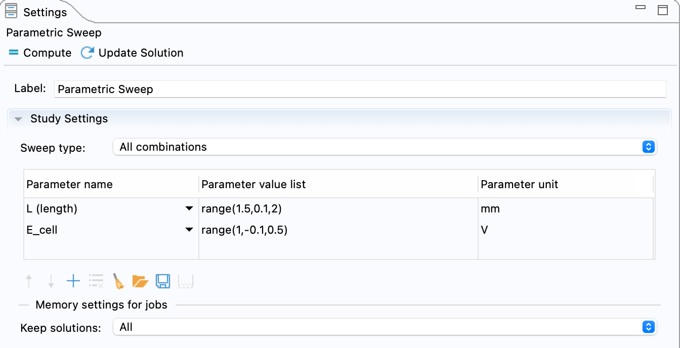
Parametric Sweep
Parametric sweep is added under study in COMSOL.
One or combinations of multiple parameters
All combinations or specified combinations
Run model with parametric sweep in batch mode:
comsol –nn 4 -nnhost 2 batch -np 52 -inputfile $inputfile -outputfile $outputfile
Notes:
For parametric sweep, it can be added under the study. In the setting window you can specify the parameter you want to sweep. It supports combination of different parameters. For the all combinations, it will sweep over all parameter combinations, for example if you have 5 values for each of the two parameters, the all combinations including 25 cases while the specified combinations include only 5 cases.
The command to run comsol model with parametric sweep in batch mode is the same with that for regular comsol model as shown here. Here we are running the job using 2 nodes, 2 mpi ranks per node and 52 cores for each mpi rank. If you want to learn how to write the sbatch file to submit comsol job, please refer to our introductory tutorial.

Slide 14
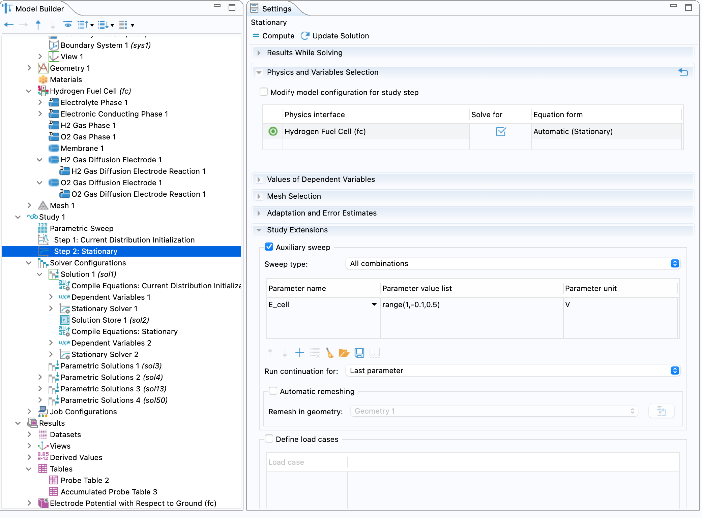
Auxiliary Sweep
Auxiliary sweep is added under steps in COMSOL.
One or combinations of multiple parameters
All combinations or specified combinations
Notes:
For auxiliary sweep, it can be defined in step. As similar as parametric sweep, the auxiliary sweep supports combination of different parameters. Remember that parameters used to define geometry and mesh can not be included in auxiliary sweep.

Slide 15
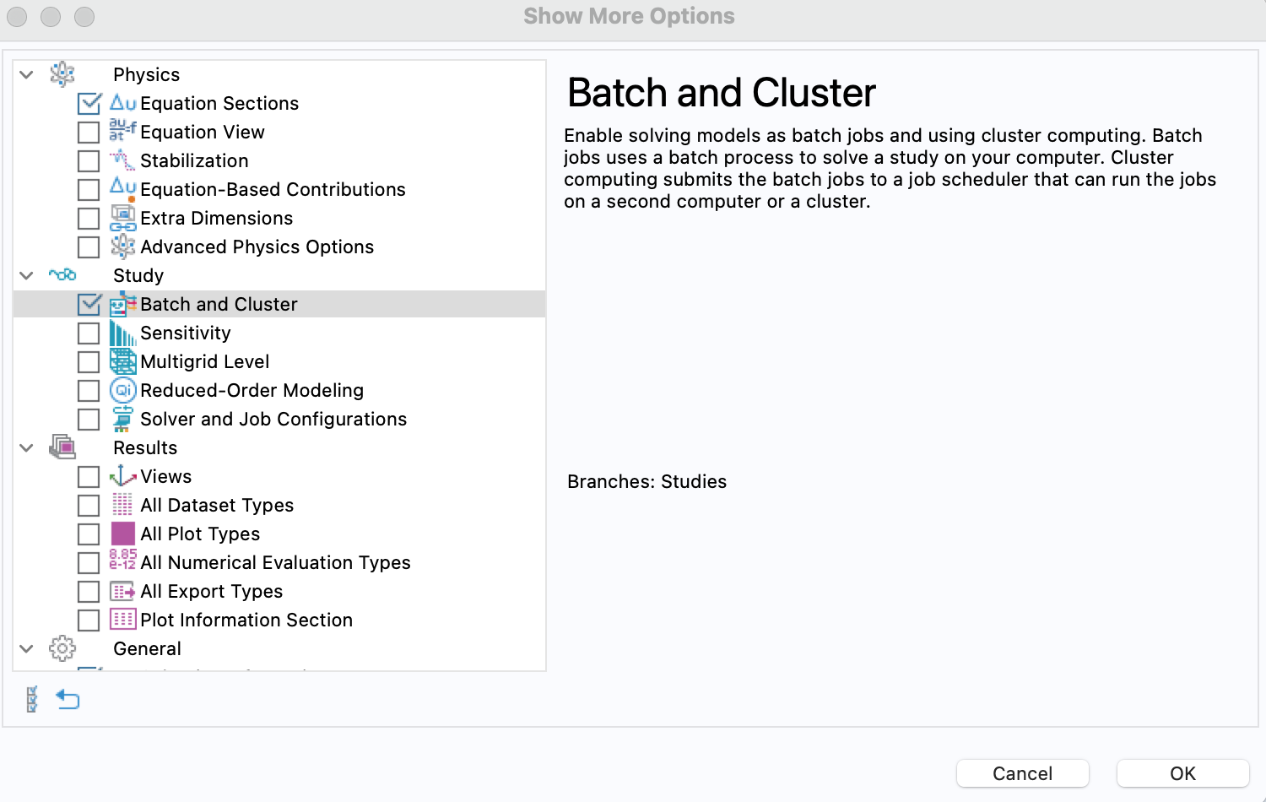
Enable Batch/Cluster Sweep
Batch sweep is not showing by default, to enable it:
Right click study node.
click show more options.
Enable Batch and cluster under study.
Notes:
By default, the Batch or cluster Sweep option is not visible. To enable it, right click study and click show more options, then select batch and cluster sweep.

Slide 16
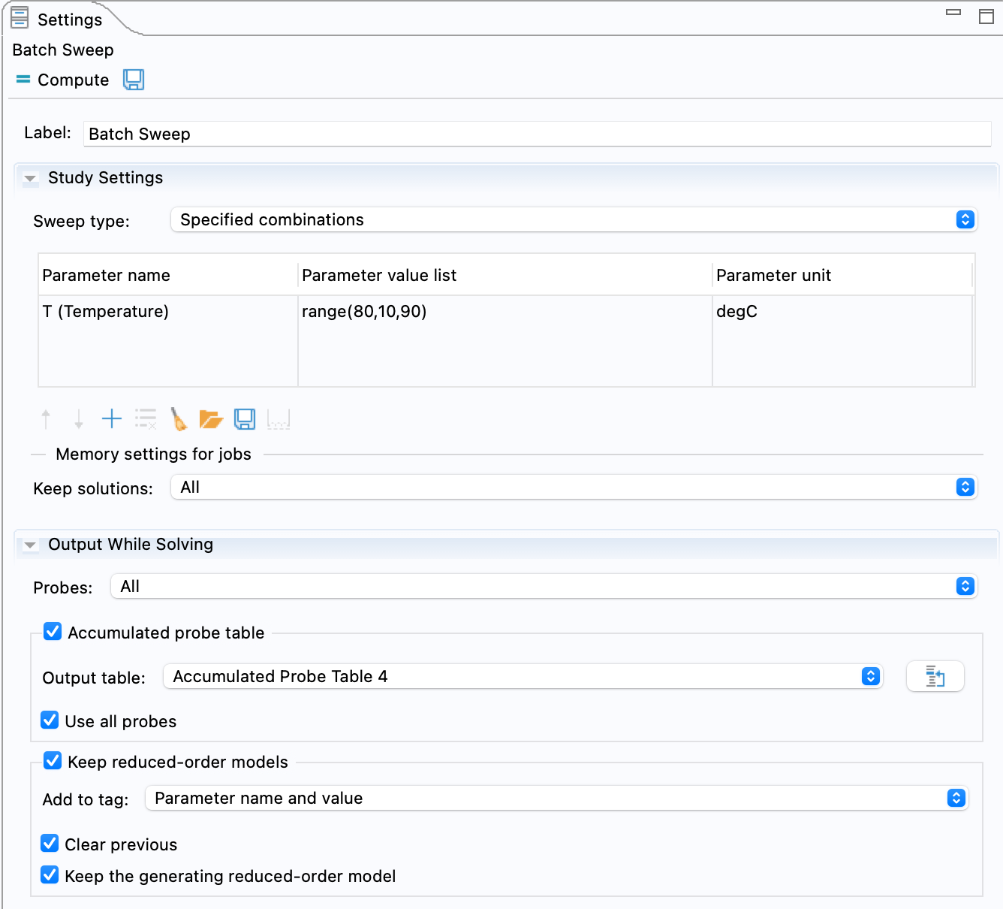
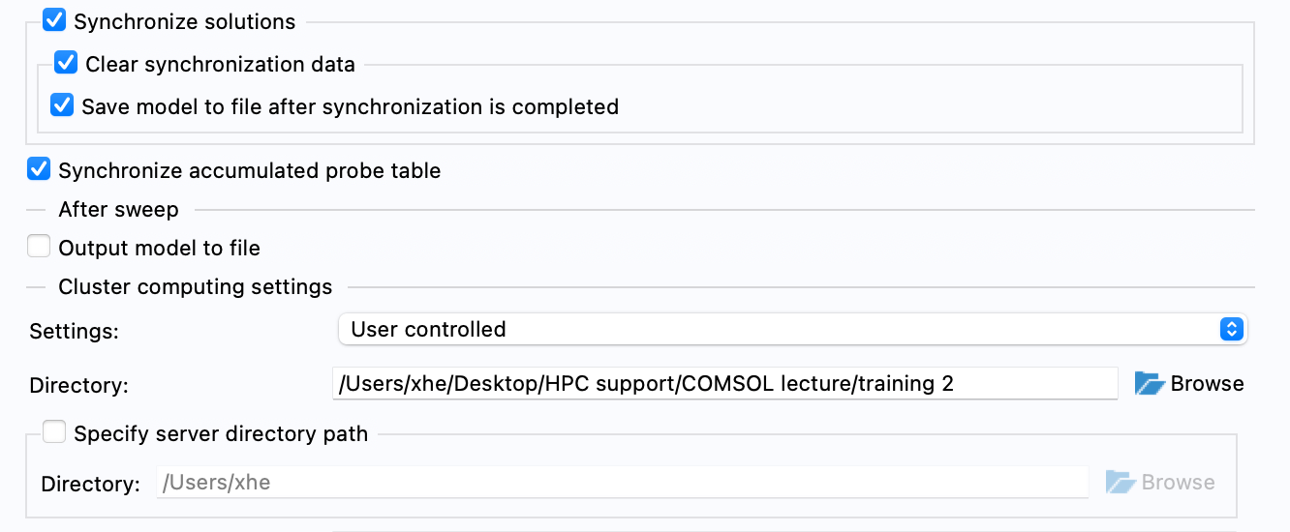
Batch Sweep
If synchronize solution is enabled, all solutions will be available in the GUI.
Each file will be saved for each parameter combination by default.
One or combinations of multiple parameters
All combinations or specified combinations
Notes:
Batch sweep can be added to step, it also support combination of multiple parameters. If synchronize solution is enabled in batch sweep, all solutions will be available in the GUI as the same as parametric sweep, otherwise, each file will be generated for each parameter value and it is hard to do the postprocessing.

Slide 17
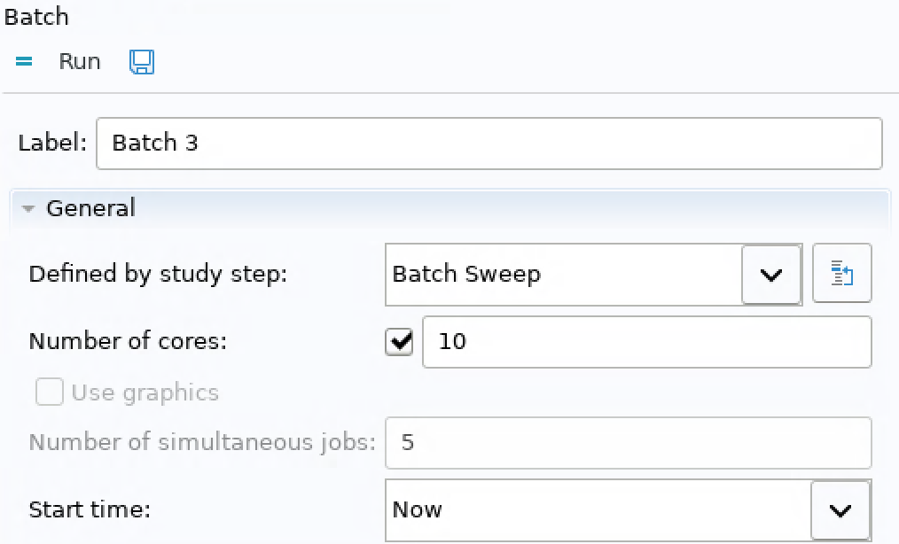
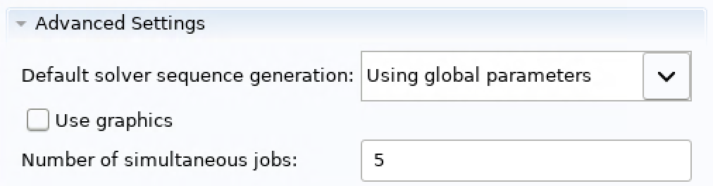
Batch Sweep
Run in batch mode
Can only run on one node in interactive environment (without using sbatch file)
Define how many simultaneous jobs:
- Batch Sweep->Number of simultaneous jobs (N1)
- Study->Job Configurations->Batch->Number of Cores (N2 per job)
- N1*N2 total cores for jobs
Notes:
Remember that, model with batch sweep can run on only one node. Also, if you want to run in batch mode, you must use interactive session instead of submiting the sbatch job. Let’s see how to submit a model with batch sweep in batch mode. Firstly, in the gui, you need specify the number of simultaneous jobs in batch sweep number of simultaneous jobs, then in study, job configurations batch number of cores, you can define how many cores will be used for each job.

Slide 18
Batch Sweep
Run in batch mode
Run interactively:
1. Login to Kestrel
2. grab a compute node
salloc –account=hpcapps –exclusive –time=00:20:00 –nodes=1 --partition=debug
3. Change directory to where the model is saved
cd /projects/hpcapps/xhe/comsol_training_2
4. Load comsol module
module load comsol
5. Submit the job
Comsol batch –mode desktop –np 2 –inputfile $inputfilename –outputfile $outputfilename
-np is the number of cores used to control the batch process, the job is using np+N1*N2 cores.
Notes:
Once the model is setup, you can login to kestrel. Then grab a compute node by using salloc command. Once the resource you requested is ready, we need change directory to where the model is saved, then load comsol module by running module load comsol, then we can submit the model using this command, Here you need replace the inputfilename with the name of model that you are going to submit, replace outputfilename by the name of file you want to save the computed model.
Here np is the number of cores used to control the batch process. The job is using np+n1*n2 cores.

Slide 19
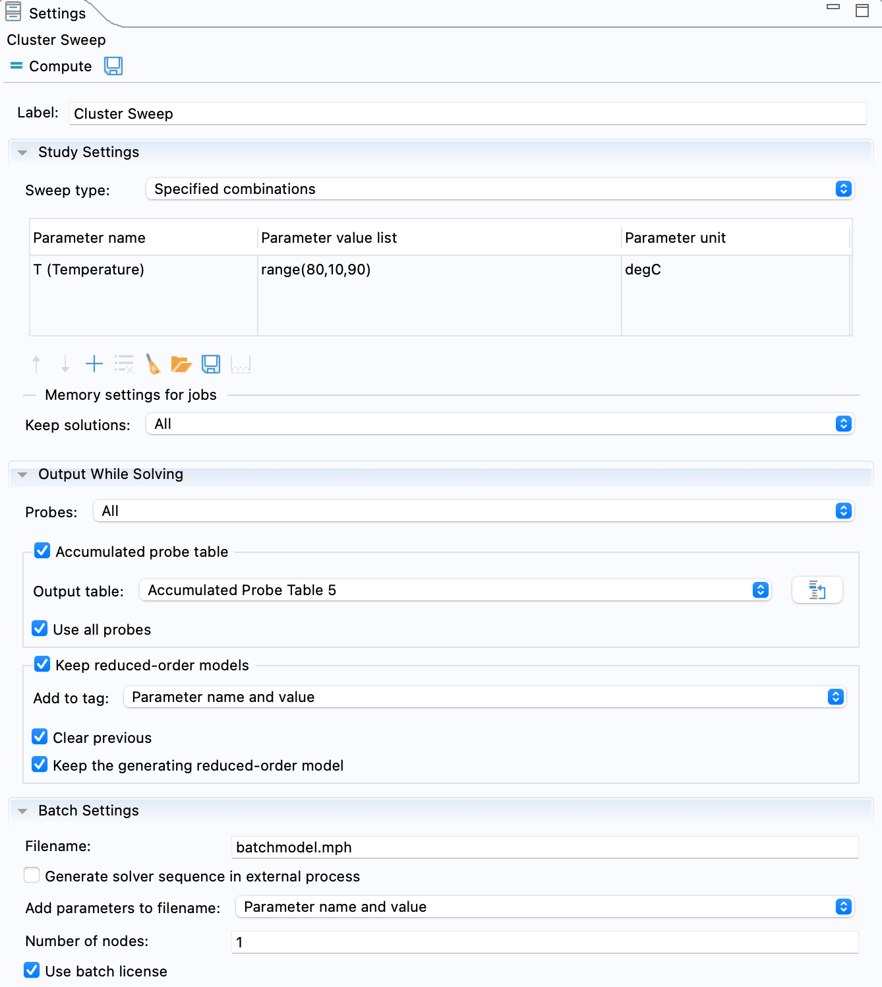
Cluster Sweep
Cluster sweep is similar to batch sweep.
Only one of batch sweep or cluster
sweep can be included in a model.
Requires floating network license.
Similar setting as batch sweep.
Notes:
Cluster sweep is similar to batch sweep but it requires floating network license and each sub job or model with different parameter value can run on multiple nodes.
The setting of cluster sweep is similar to that of batch sweep.

Slide 20
Note!
If the batch/cluster sweep is included in model, they are ignored if you submit the job in batch mode by default.
In order to include the batch/cluster sweep when submit job in batch mode:
Add flag: -mode desktop
For more information about parametric study:
https://www.comsol.com/support/knowledgebase/1250
comsol batch -mode desktop -inputfile inputfilename.mph -outputfile outputfilename.mph
Notes:
Attention here, if the batch/cluster sweep is included in model, they will be ignored if you submit the job in batch mode. In order to include the batch/cluster sweep in batch mode, you need add a flag –mode desktop. For more information about parametric study in comsol, you can access the documentation through this link.

Slide 21
3
Equation-Based Simulation
Notes:
Next, let’s talk about equation-based simulation.

Slide 22
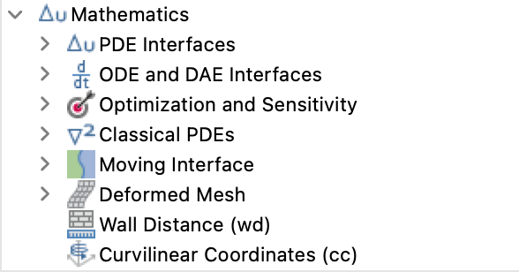
Equation-based Simulation
Why?
PDEs that not included in any module in COMSOL
Complicated boundary conditions or constrains from experiments
Mathematics Module
Notes:
For your specific problem, if the governing equation is not included in any module in COMSOL, or you need to implement complicated boundary conditions or constrains from experiments, you need run equation-based simulation. In this case, comsol is more like a PDE solver based on FEM. There is a pde interfaces under the mathematics module in comsol.

Slide 23
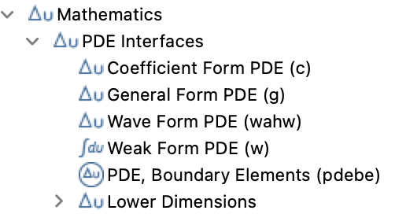
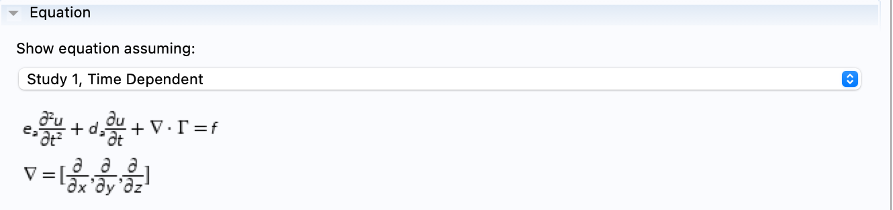
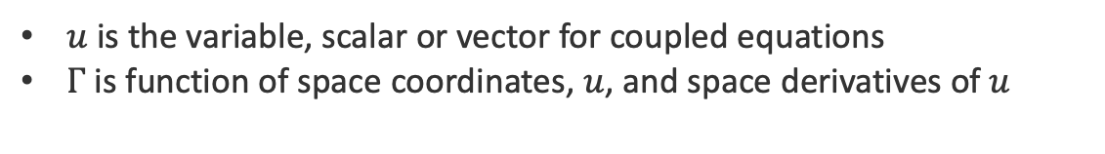
Equation-based Simulation
PDE Interfaces
Some common PDE are specified
Support defining of general PDE
General form PDE
$u$ is the variable, scalar or vector for coupled equations
$Γ$ is function of space coordinates, $u$, and space derivatives of $u$
Notes:
You can see in this image, the PDE interface specifies some common PDE, also, it supports defining general pde with this form. Here u is the variable, it can be scalar or vector for coupled pdes. Gama, f, e and d are functions of space coordinates, variable u and the space derivative of u. Once gamma, f ,e and d, are defined the form of PDE is defined. Then we need add boundary conditions.

Slide 24
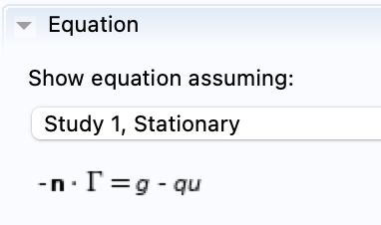
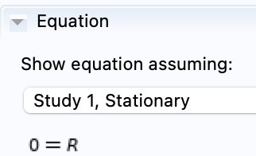
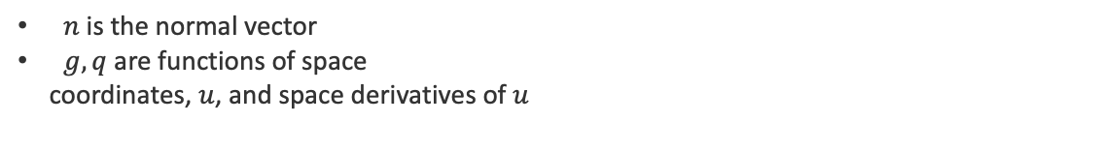
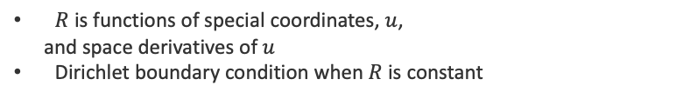
Equation-based Simulation
Neumann BC (flux)
Constrains
$n$ is the normal vector
$g, q$ are functions of space
coordinates, $u$, and space derivatives of $u$
$R$ is functions of special coordinates, $u$,
and space derivatives of $u$
Dirichlet boundary condition when $R$ is constant
Built-in Operators: https://doc.comsol.com/5.5/doc/com.comsol.help.comsol/comsol_ref_definitions.12.026.html
Notes:
For boundary conditions, the general form is like this, where n is the normal vector, g q are functions of space coordinates, variable u and space derivative of u. Also, you can define any types of constrains by defining the expression of function R explicitly. In order to define these expressions, we need refer to the built-in operators which can be found here.

Slide 25
4
Parameter Estimation
Notes:
Next, lets move forward to parameter estimation.

Slide 26
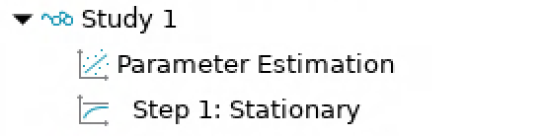
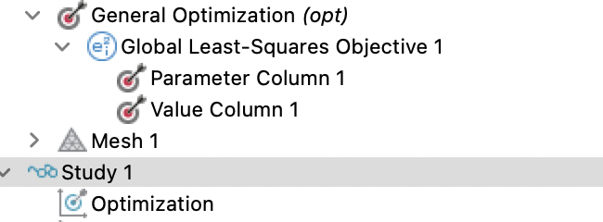
Parameter Estimation
Usually: build model -> input parameters -> get Results
Results from experiments or literature -> predict parameters for theoretical or FE model?
Parameter estimation node under step or using optimization
module.
Notes:
In numerical simulations, we typically build the model, provide all parameters and get results. However, under certain situations, one or more parameters are unknown in our model, and they are hard to be measured directly by experiments. In this case, we need run inverse modeling, in which we predict the unknown parameters based on data from experiments or literature. In comsol, there is a node called parameter estimation to fulfill these needs. Also the optimization module provides the way to handle this.

Slide 27
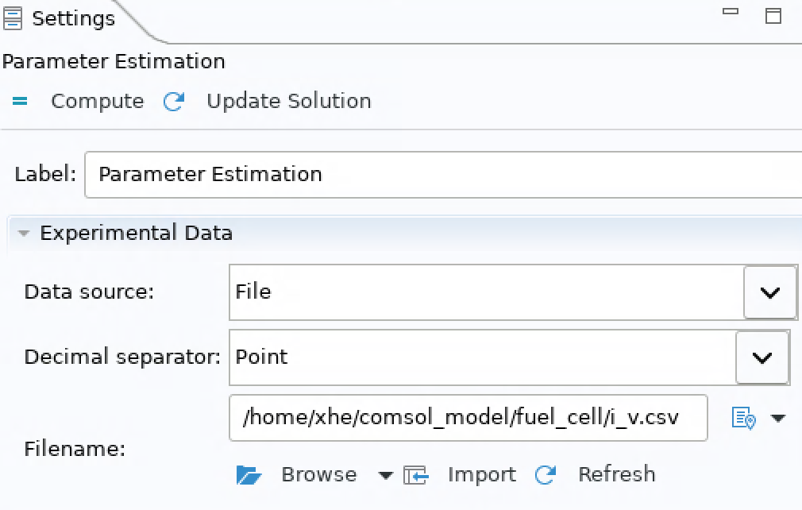
Parameter Estimation
Steps (parameter estimation)
Set up the model as usual;
Add parameter estimation node under step;
Import experimental data;
Notes:
To run this parameter estimation using the parameter estimation node, we need set up the model as usual, give an arbitrary number to the unknown parameter, add the parameter estimation node under step, then import experiments data.

Slide 28
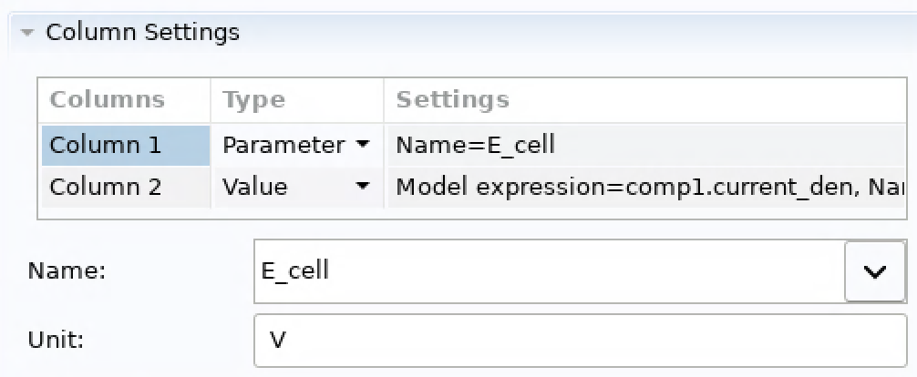
Parameter Estimation
Steps (parameter estimation)
Data setting (column data):
- column 1 is the parameter
- columns 2… are values obtained for different parameters
Notes:
Assume we want to estimate the exchange current density at anode based on i-v curve data. As we are sweeping the potential in the model, so the potential in first column of the imported file is variable, the predicted current density in second column is value.

Slide 29
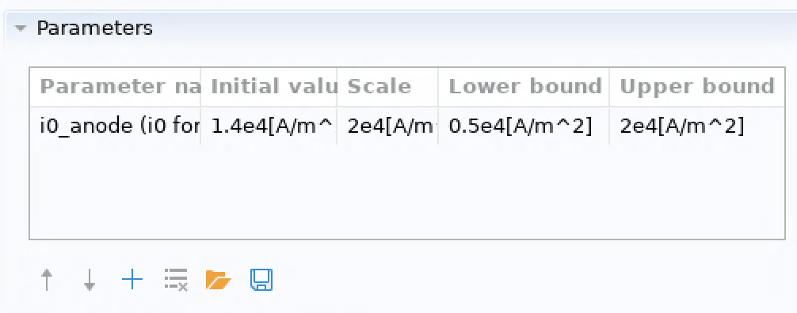
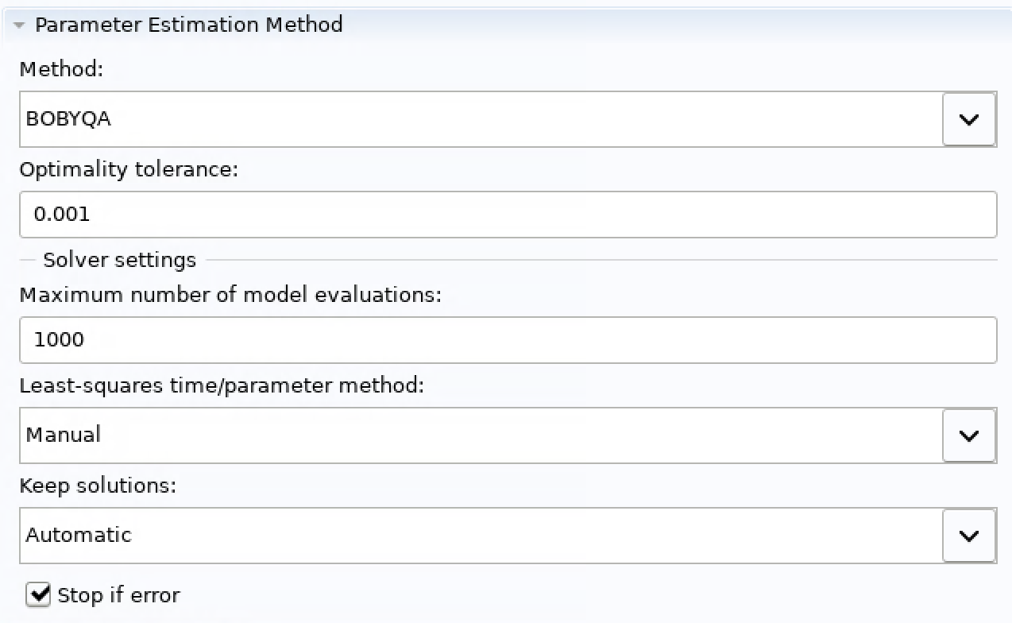
Parameter Estimation
Steps (parameter estimation)
Define parameters that you want to estimate:
$$scale=max⁡(|lower bound|,|upper bound|)$$
Select method and set the solver:
Notes:
Then we need Specify which parameter you want to estimate. Here is i0_anode for our case. Give an initial value lower, and upper bounds for this parameter. Based on documentation, the scale should be set as similar as maximum of the absolute of lower or upper bound. Then select method and set the solver, the parameter estimation node is all set. By compute the model, an estimation of the parameter will be provided.

Slide 30
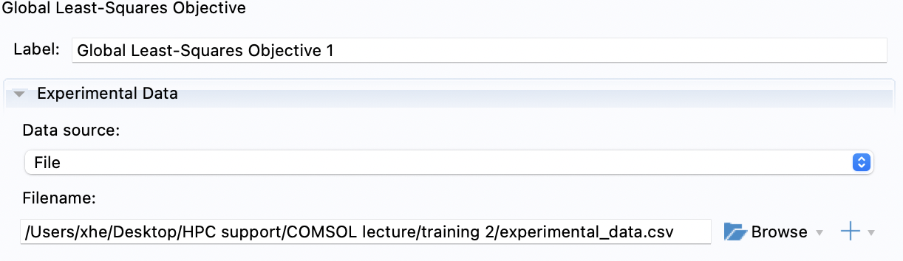
Parameter Estimation
Steps (optimization module)
Set up the model as usual;
Add General Optimization physics;
Add Global Least-Squares Objective;
Import experimental data;
Notes:
If you want To run parameter estimation using optimization module, you also need set up the model as usual, give an arbitrary number to the unknown parameter, add the general optimization physics, then add the global least-squares objective in which experimental data will be read in.

Slide 31
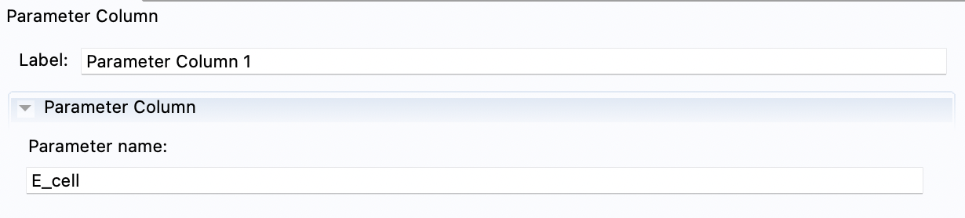
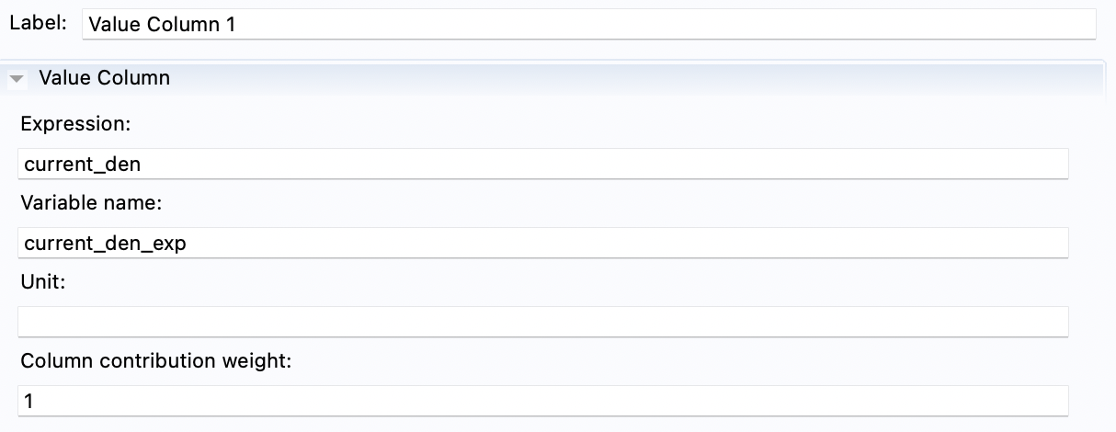
Parameter Estimation
Steps (optimization module)
Add Parameter Column under Global Least-Squares Objective;
Add Value Column under Global Least-Squares Objective;
Notes:
Under the global least-squares objective, we need add parameter column to indicate that the first column is variable. Then a value column to state that the second column is measured value that need to be matched.

Slide 32
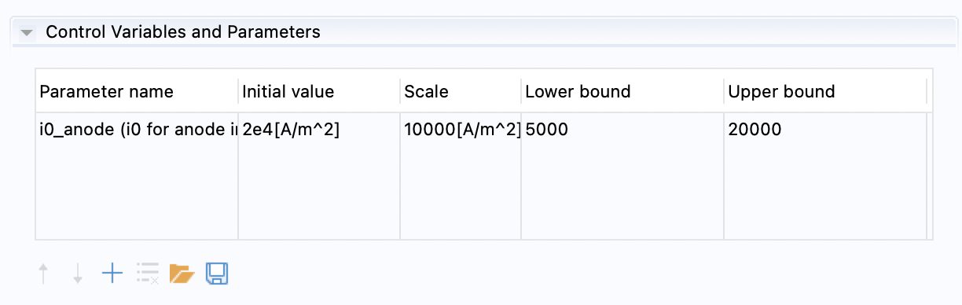
Parameter Estimation
Steps (optimization module)
Add Optimization step under Study;
Specify the parameter to be estimated;
Select method and set the solver:
Notes:
Then the last step is to add optimization step under study, in this step, we need specify the parameter we want to estimate, then select method and set the solver. The running of this optimization step will return the estimated parameter.

Slide 33
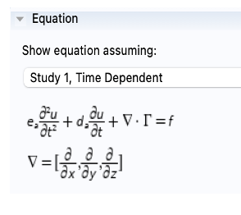
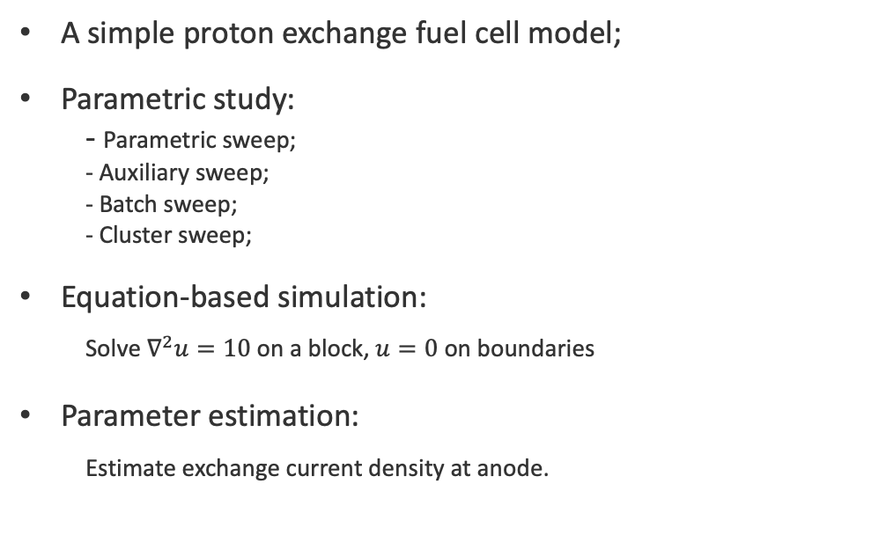
Demo
A simple proton exchange fuel cell model;
Parametric study:
- Parametric sweep;
- Auxiliary sweep;
- Batch sweep;
- Cluster sweep;
Equation-based simulation:
Solve $∇^{2}u=10$ on a block, $u=0$ on boundaries
Parameter estimation:
Estimate exchange current density at anode.
Notes:
In order to give you a better understanding about how to use these functions, I would like to give a demo. First, let’s look into a simple proton exchange fuel cell model.

Slide 34
To learn more
Fuel cell module:
https://doc.comsol.com/6.0/doc/com.comsol.help.fce/FuelCellAndElectrolyzerModuleUsersGuide.pdf
Parametric study:
https://www.comsol.com/support/knowledgebase/1250
Equation-based simulation:
https://doc.comsol.com/5.3/doc/com.comsol.help.comsol/comsol_ref_equationbased.23.007.html
Parameter estimation:
https://www.comsol.com/blogs/how-to-use-the-parameter-estimation-study-step-for-inverse-modeling/
Notes:
That’ pretty much the tutorial for today, if you want to learn more about the functions we talked about, you can refer to the documentation through these links.

Slide 35
Resources
Creating an HPC account
https://www.nrel.gov/hpc/user-accounts.html
Getting a pilot allocation: (necessary to use Kestrel)
Instructions: https://www.nrel.gov/hpc/resource-allocation-requests.html
Request link: https://hpcprojects.nrel.gov/
Additional information about allocation units: https://www.nrel.gov/hpc/system-resource-allocation-unit.html
Getting started on Kestrel
HPC FAQ: https://nrel.github.io/HPC/Documentation/getting_started/
Running a job: https://nrel.github.io/HPC/Documentation/Slurm/batch_jobs/
Running an interactive job: https://nrel.github.io/HPC/Documentation/Slurm/interactive_jobs/
Moving data between your laptop and Kestrel: https://nrel.github.io/HPC/Documentation/Managing_Data/Transferring_Files/
Other computing questions/inquiries, email:
hpc-help@nrel.gov
Notes:
In addition, if you want to learn more about kestrel, you can refer to these resources Or submit a ticket to hpc-help@nrel.gov and we can help you to figure things out.

Slide 36
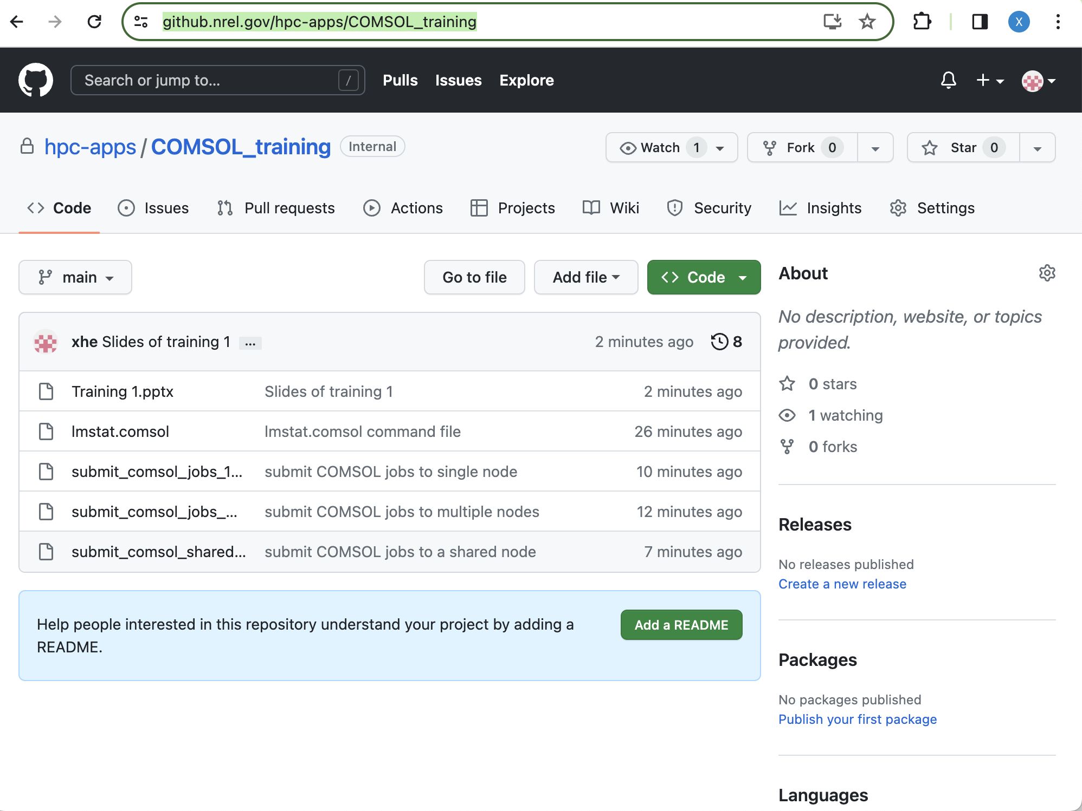
GitHub Repo
GitHub Repo
https://github.nrel.gov/hpc-apps/COMSOL_training
Notes:
By the way, the slide of this training and the recording will be posted to a github repo and you can access it through this link.

Slide 37
Thank you, questions?
Notes:
That’s all I have for this tutorial. Thank you for your attention. I am open to answer any questions you may have.

